Slide 1
Welcome to the School of
Care and Health Science

Slide 2
Meet Our Specialist Team:
Group Curriculum Director for Health and Social Care and Early years:
Susan Clark – Specialism: Early Years Educator and Psychologist
Senior Curriculum Managers:
Linda Blake: Early years (Tower) – Specialism: Educationalist
Jennifer Dillon: Early years (Hackney)– Specialism: Early Years Educator
Victoria Corcoran: Health and Social Care (Tower)– Specialism: Nurse
Anthea Rowley: Health and Social Care (Hackney) – Specialism: Health specialist
Gloria Burns: Health and Social Care and Early years (Epping) – Specialism: Sociologist
Bobbi Ehsan: Health and Social Care and Early Years (Redbridge) – Specialism: Early Years Educator
Jenny Ritchie: Work Based Learning and Apprenticeships – Specialism: Nurse

Slide 3
16-19 Study Programme
The programme consists of:
English and Maths (depending on previous qualifications) and Work Experience alongside one of the following courses.
Level 1 – Diploma in Health and Social Care
Level 2 – Diploma in Health and Social Care
Level 3 – Diploma in Health and Social Care (Years 1 and 2)

Slide 4
High expectations leads to your success
Excellent attendance
Excellent punctuality
Professional attitudes modelling professional behaviour.
Supporting outstanding work placement
Respect Individuality and value diversity
Positive attitude
A vocational interest in caring for others.

Slide 5
Our 16-18 Course offers:
L1 Diploma in Health and
Social Care
The course is portfolio based. It gives you an introduction to HSC and the wide range of jobs available as well as an opportunity to move to Level 2 and progress. You will study a range of units including :Communications, Equality and Diversity, Health and Safety
The course is portfolio based. It gives you an introduction to HSC and the wide range of jobs available as well as an opportunity to move to Level 3 and progress to university. you will study a range of units including :Communications, Equality and Diversity, Health and Safety, as well as a range of units including Nutrition, Dementia Awareness, Stoke Awareness and Research Project.
L2 Diploma in Health and
Social Care
L3 Diploma in Health and
Social Care
This course is suitable for those seeking to work professionally within the Health Sector, providing a valuable foundation for progression into Higher Education, Higher Level Apprenticeships or straight into employment. This course is an excellent choice for students interested in healthcare careers such as nursing (children, adult, mental health), midwifery, paramedic, radiography, occupational therapy, physiotherapy, laboratory technician, public health specialist or working in health promotion.
All our Health and Social care courses require you have a clean, enhanced DBS check.

Slide 6
Progression – What does your course lead to:
Learners have a wide range of opportunities while on the Health and Social Care courses, this leads to enhanced CV’s containing a wide range of experience.
100% of learners applying for university gain their first choice.
Learners are supported and encouraged to gain work experience which is relevant to their chosen field. Outstanding feedback about learners undertaking placements in Schools and many are offered paid employment opportunities.
L1 Diploma in Health and Social Care
L2 Diploma in Health and Social Care
This qualification provide the additional stretch and challenge that will support learners to progress to the next level of vocational learning.
L3 Diploma in Health and Social Care
This programme provides knowledge and skills that enable learners to become occupationally ready to take up employment in the health and social care sector. This can follow either directly after achieving the qualification, or via the stepping stone of Higher Education (HE) in university or college.

Slide 7
Our 19+ Course offers:
L1 Diploma in Health and
Social Care
The course is portfolio based. It gives you an introduction to HSC and the wide range of jobs available as well as an opportunity to move to Level 2 and progress. You will study a range of units including :Communications, Equality and Diversity, Health and Safety
The course is portfolio based. It gives you an introduction to HSC and the wide range of jobs available as well as an opportunity to move to Level 3 and progress to university. you will study a range of units including :Communications, Equality and Diversity, Health and Safety, as well as a range of units including Nutrition, Dementia Awareness, Stoke Awareness and Research Project.
L2 Diploma in Health and
Social Care

Slide 8
Our 19+ Course offers:
L3 Access to Nursing
The Access Diploma will help learners to build on existing skills and provide a good grounding for further academic study. Progression routes include:
Higher education programmes in adult nursing, mental health nursing, paramedic science, radiography, social work, psychology, public health, occupational therapy and other healthcare careers.
CPCAB Counselling Programmes: L2, L3, L4 (Epping)
This is a very recognised route to becoming a professional counsellor. These are part time evening courses delivered by a team of practising counsellors with extensive teaching and expertise. These courses comprise a mixed of academic and practical sessions in order to develop skills in counselling. On completion of the Level 4 learners have the knowledge, skills and competencies to work as a therapeutic counsellor in an agency context.

Slide 9
What kind of things do we in Health and Social care ?
Trips and visits
Practical lessons –resources
Have Guest speakers come in
Attend Conferences and exhibitions
In class you will also:
Complete assignments and other fun tasks
Carry out team projects
Plan activities

Slide 10
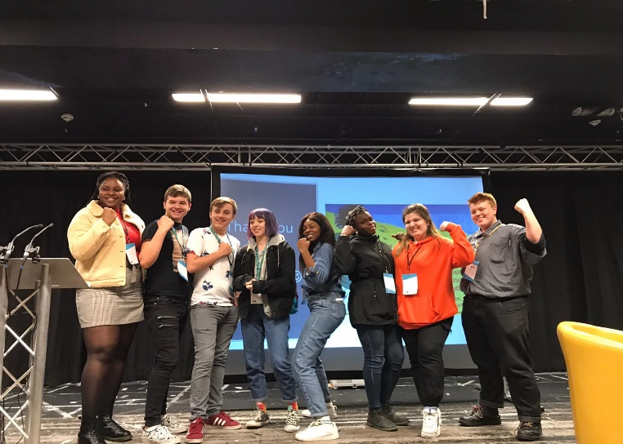
Sustainability Conference Sheffield
Three students who joined the My World My Home programme at New City College, Hackney travelled to Sheffield on Monday 4th November for the NUS & SOS Sustainability Summit. The Health and Social Care students joined 220 students and staff from colleges and universities around the country for a day of workshops, talks and panel discussions with some of the UK’s top environmental activists and campaigners, from organisations including Friends of the Earth and People and Planet, as well as the students and students' unions leading the youth climate movement.

Slide 11
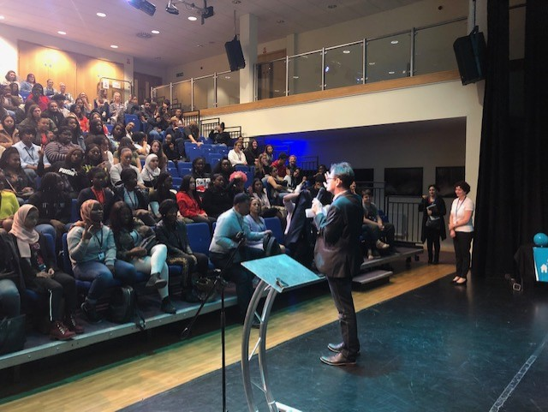
Health and Social Care Students Conference – WOW World of Work.
Students benefited from a day of guest speakers from health care organisations such as NHS, local hospice, apprenticeship provider and other healthcare and educational organisations.

Slide 12
Our Volunteer Success Stories
A second year level 3 BTEC learner has been accepted as a Maternity Mate on the maternity ward.
A level 2 18 year old learner has been accepted as a volunteer on the hospitals volunteering programme
A level 3 first year learner has been volunteering for 8 months at her local hospital.
A level 3 first year learner has gained a two week block placement on the maternity ward.
A further 3 learners have been accepted and are in the process of been allocated start dates having completed the process fully to start their roles.
Many of our learners are gaining direct experience working in domiciliary care, residential care homes, health charities and other providers and some are in paid work within the sector.

Slide 13
Support for you:
Work experience opportunities to support you choosing your future career.
Help to plan your future - whether to move into further or higher education, into work or training
Guidance on choosing university courses, student finance and how to submit applications as well as a full range of College and University prospectuses.
Employability skills - help with job searches and the application process - form filling, CV writing and practice interviews in HSC sector
English and Math's retakes to support your progression

Slide 14
NCC Redbridge results have improved year on year and are now a massive 7% above national average for 16-18 achievement ​ NCC Epping Forest achievement is 13.6% higher than the previous year. 16-18 results are now 3.5% over the national average. ​ NCC Tower Hamlets has seen its highest ever set of results - now nearly 5% above national average!​ NCC Hackney has achieved its best ever overall achievement rate and is also above national average. UCCESS

