Slide 1
School of Hospitality & Culinary Arts

Slide 2
Welcome
Hello and welcome to the School of Hospitality & Culinary Arts at New City College
We are sorry that we cannot see you face to face but hope that you will find this presentation informative and encourage you to join our team in September

Slide 3
Our Courses 2020/2021
Level 1 Diploma in Introduction to Culinary Arts
Level 1 Diploma Introduction to Hospitality
Level 2 Diploma in Hospitality Services
Level 2 Diploma in Culinary Arts
Level 2 Diploma in Food Production & Cooking
(Adult only @ Hackney)
Level 3 Diploma in Professional Cookery
Level 3 Diploma in Food and Beverage Service Supervision

Slide 4
Intention
Our main aim and ethos is to produce well equipped and work-ready catering & hospitality professionals.
The curriculum has been designed around a Learning Company model. From day one our trainees enter a real working environment and professional atmosphere. Our trainees work in our award winning restaurants and on a wide variety of internal and external events alongside our vastly experienced team.
You will be paid to work for us so this is a great opportunity to earn while you learn!!
100% of our learners complete industry work placements!
We work closely with employers and industry standards bodies to ensure that our curriculum meets the needs of todays and tomorrows workforce.
The cornerstone of our curriculum is inclusivity and we take a whole person approach to produce healthy, confident, resilient and well rounded individuals regardless of their starting point or personal circumstances

Slide 5
Implementation
As a trainee you will sign up to our departmental standards and behaviours on day one. These are a basic set rules which form the basis of our approach and are designed to promote a safe, professional, respectful and vibrant working environment for students and staff. Ambition and attainment are rewarded while poor behaviour is not tolerated.
You will be interviewed and our team will give you personalises advice and guidance to create the correct learning journey to match your career aspirations and goals. These goals and progression are monitored and reviewed throughout your educational journey. Teaching, learning and assessment reflects this individualised and holistic approach. All aspects of our curriculum is designed to be meaningful and offer you as realistic an experience as it is possible to offer
.

Slide 6
College Video
https://youtu.be/vyEEn6APQ6E
https://youtu.be/WlJ8hCdD-G0

Slide 7
About us
While studying you will have the opportunity to have paid work in our multi award winning restaurants, this year we were awarded an AA rosette and Gold People 1st Accreditation

Slide 8
About us
Last year some of our trainee chefs reached the finals of several National competitions. Making unforgettable memories and winning some amazing prizes!
All students are given the opportunity to join our Academy Programme & Culinary Competition Teams. Only the best of the best will be accepted!

Slide 9
ZEST QUEST WINNERS
Our amazing competition team competed at the Zest Quest Finals at the Hilton Heathrow.
Winning the Tilda award for best use of rice
Their prize was an all expenses paid culinary trip to Milan in Italy

Slide 10
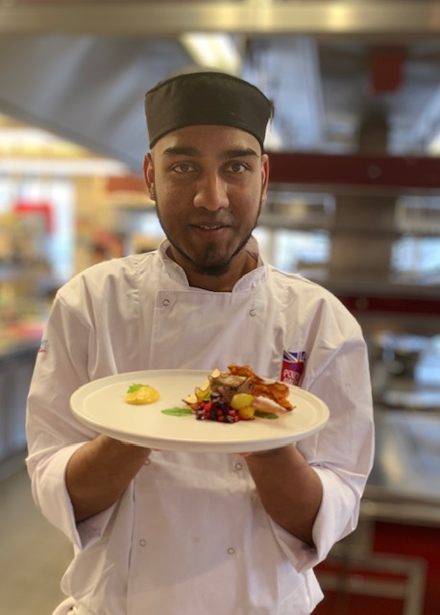
SIVEN Jr PILLAY
THE UK CHAMPION
Siven won the British
Poultry Awards Competition in the finals held at The University of Birmingham.
He then had the opportunity to present his dish on the menu for the gala dinner at London’s famous Sheraton Hotel

Slide 11
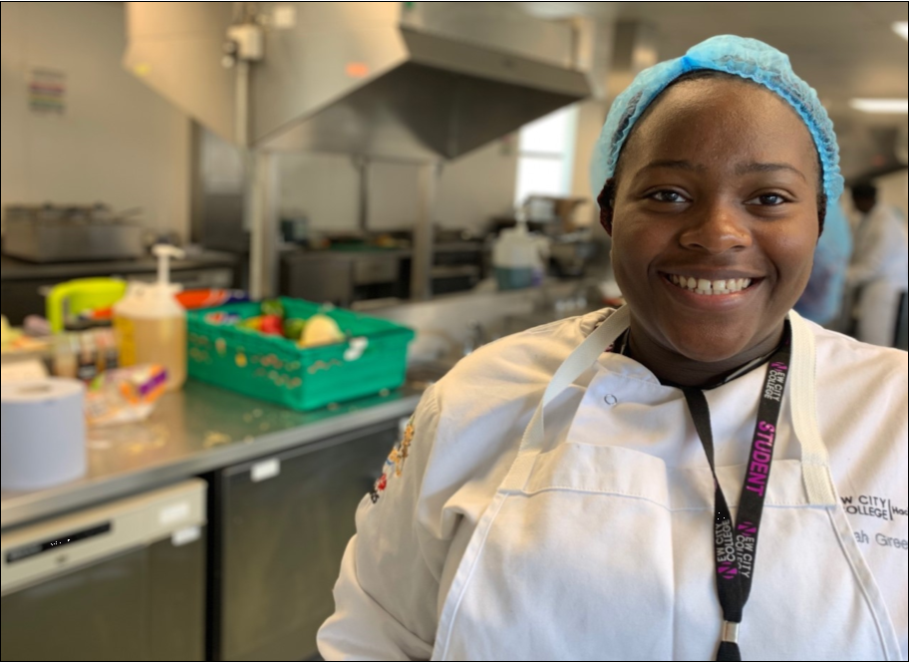
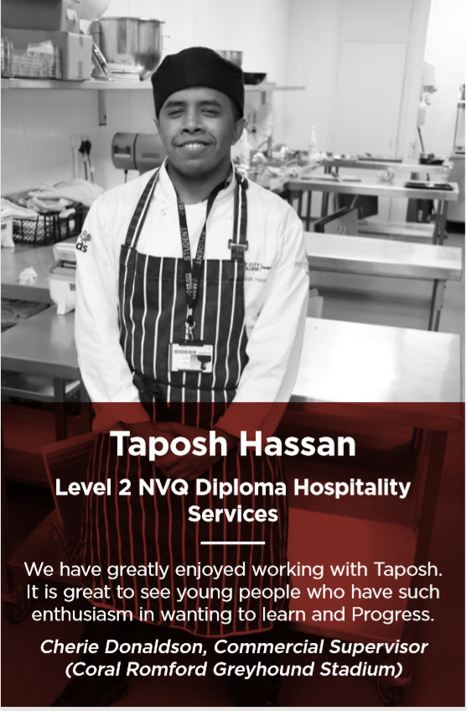
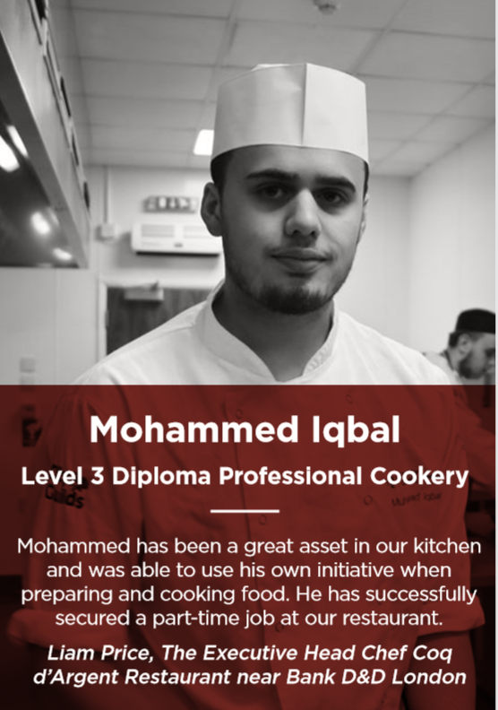
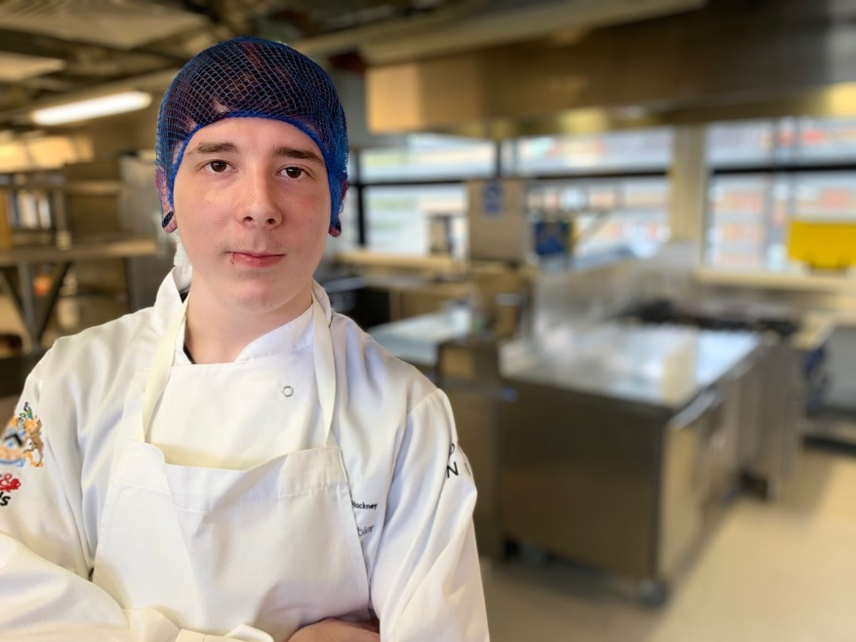
Work Placements
The restaurant was amazing
and I have been offered a
part time job as a pastry chef”
Taiyakah .
Bluebird Café
Chelsea
It really boosted my confidence
in believing that I have
what it takes to make it in a top
professional kitchen”
Josh
100 Wardour St

Slide 12
Finally
On behalf of all the staff, thank you for logging in and we hope you enjoyed the presentation
If you have any further questions please contact;
Maurice.Haskew@ncclondon.ac.uk
Justin.mcnamara@ncclondon.ac.uk

